Slide 1
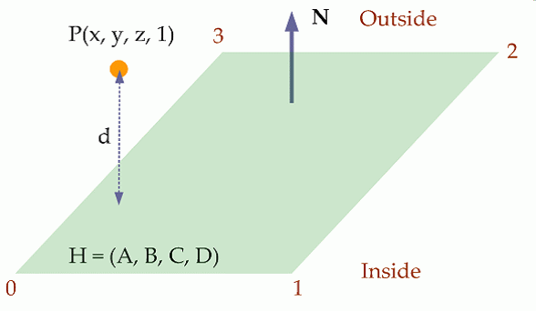
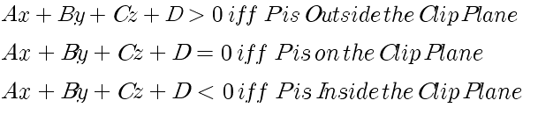
Why d = H〮P ?

Slide 2
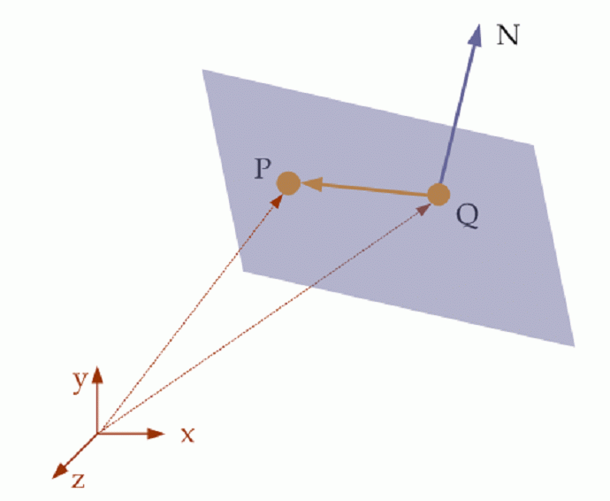



평면 표현

Slide 3
Q
P’
P’ = Q + (P-Q) – dN
P’ 〮 N = Q 〮 N
(Q + (P-Q) –dN) 〮 N = Q 〮 N
P 〮 N + D = dN 〮 N = d ➔ Ax+Bt+Cz+D => d

